Slide 1
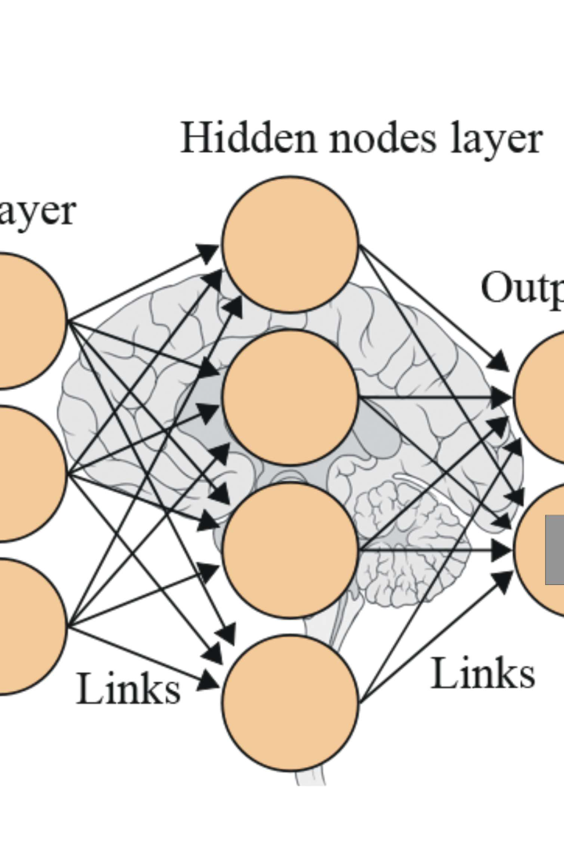

Spam Email Detection Using Machine Learning Model
Welcome to the presentation on "Spam Email Detection Using Machine Learning Model." This project aims to revolutionize email security by leveraging advanced machine learning techniques to detect and prevent spam emails.
Ayush
Priyanshu Tandon
Ankit Kumar

Slide 2

Abstract: A Brief Overview of the Project
1
Objective
The abstract provides a concise summary of the project's goals, methodologies, and outcomes.
2
Significance
It highlights the importance of enhancing email security through innovative machine learning approaches.
3
Key Points
Summarizes the main aspects of the project for a quick insight into the work.

Slide 3
Introduction: Unveiling the Need for Advanced Email Security
Email Security Challenges
Importance of Security
Introduction to Machine Learning
Highlighting the critical need for robust email security measures.
Exploring the evolving landscape of email threats and vulnerabilities.
Introducing the application of machine learning in addressing email security concerns.

Slide 4
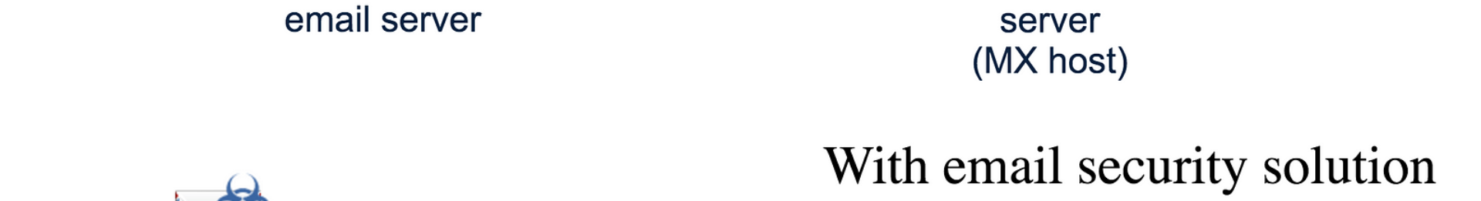
Project Overview: Enhancing Email Security with Machine Learning
1
Initiation
The inception of the project and the primary objectives set forth.
2
Development Phase
The iterative process of building and refining the machine learning model.
3
Implementation
The deployment and integration of the model into the existing email security infrastructure.

Slide 5


Problem Statement and Scope: Defining the Challenges and Boundaries
Challenges

Slide 6



General System Analysis: Understanding the Key Components
Data Collection
Feature Engineering
Model Evaluation
Gathering and preprocessing email data for model training.
Identifying and extracting relevant features for effective classification.
Assessing the performance and accuracy of the machine learning model.

Slide 7
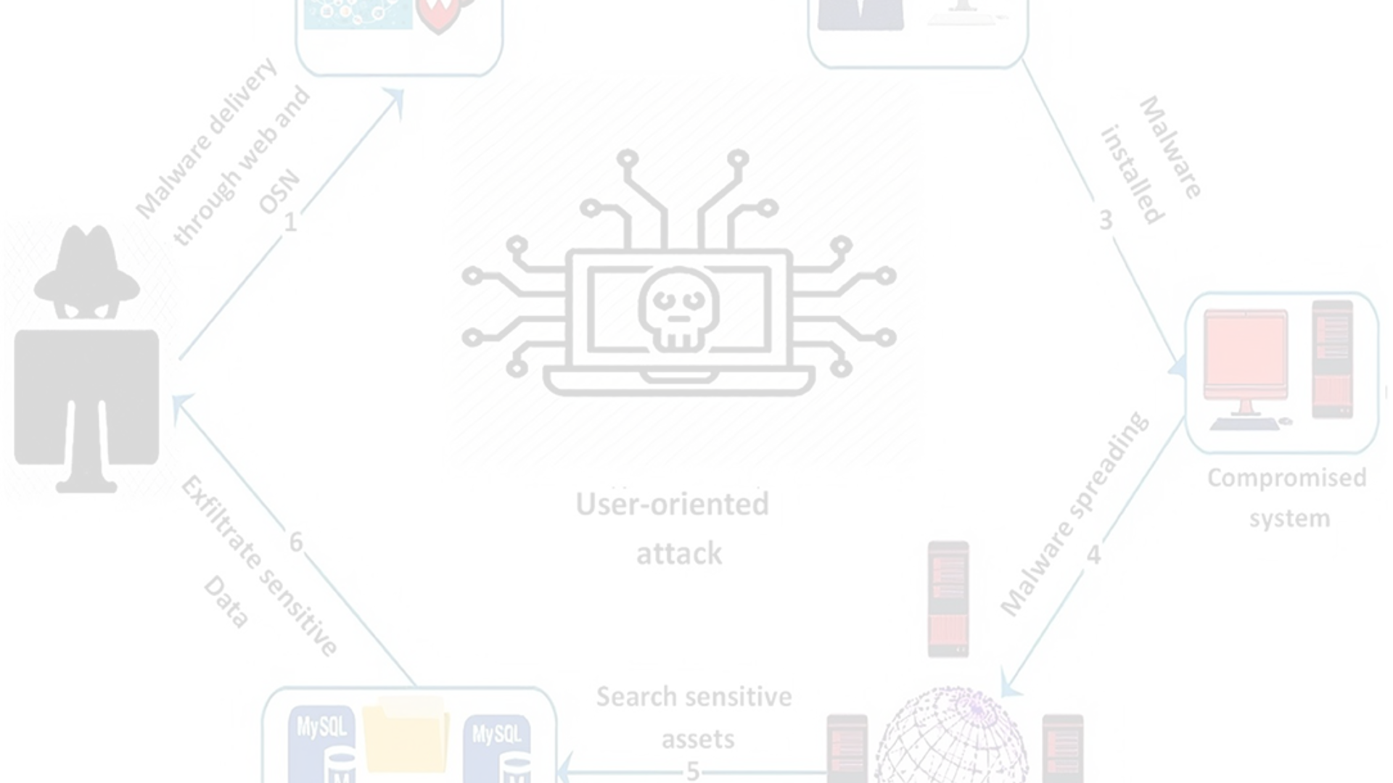
Preliminary Investigation: Exploring the Landscape of Email Threats
Malware Attacks
Social Engineering
Impersonation Threats
Exploration of malware-based email threats and their potential impact.
Analysis of social engineering tactics employed in phishing emails.
Identification and examination of impersonation-based email impersonation.

Slide 8
Literature Review: Insights from Research Papers and Base Articles
Key Findings
Identifies significant research findings in the domain of email security and machine learning.
Knowledge Gap
Evaluates the existing knowledge gap and areas for further research and development.

Slide 9
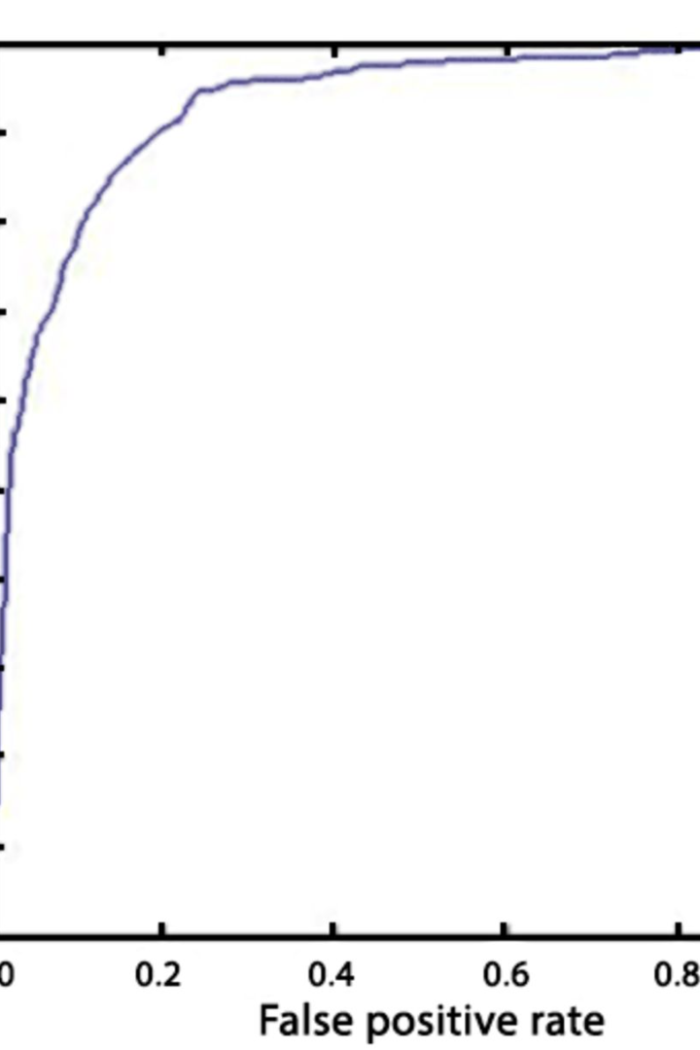
Feasibility Study: Assessing the Viability of Machine Learning in Email Security
Viability Assessment

Slide 10
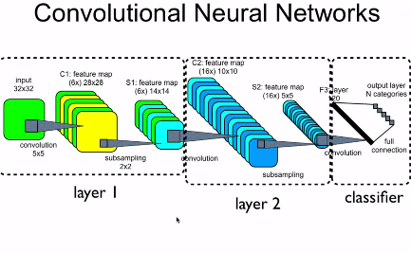
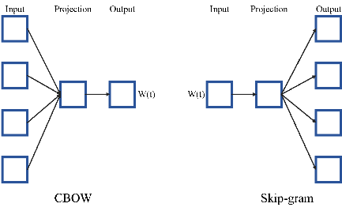

Functional Requirements: Outlining Key Features for Effective Spam Detection
Data Processing
Classification Algorithms
Real-time Detection
Efficient processing of email data for feature extraction.
Utilization of advanced machine learning algorithms for classification.
Instantaneous identification and flagging of spam emails.

Slide 11
Non-Functional Requirements: Beyond Functionality for a Robust System
Scalability
Security Measures
User Experience
Evaluating the system's ability to handle large-scale email traffic.
Implementation of additional security layers for enhanced protection.
Focus on creating an intuitive and secure user experience.

Slide 12
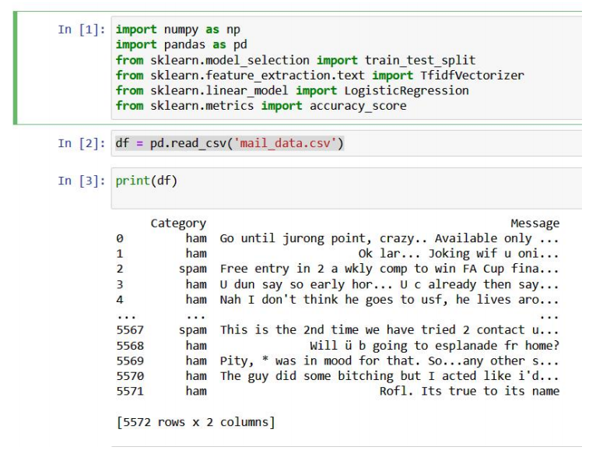
Code Snippets
Importing libraries:
giving name to dataset->

Slide 13
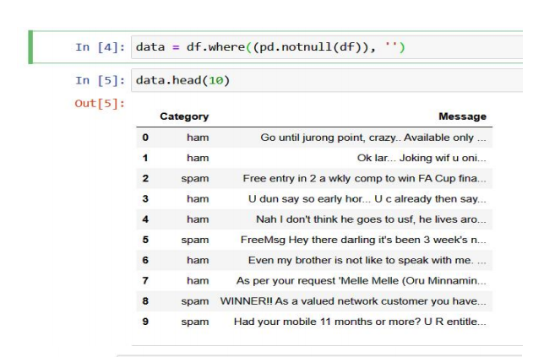
Removing extra spaces and non-useful indentation:

Slide 14
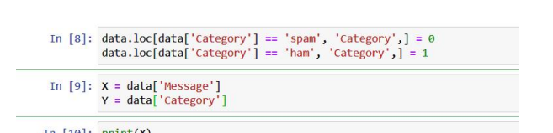
Assigning a number to spam and not spam email for easyness:
Assigning variables to both message
and category ->
columns to perform operations

Slide 15

Splitting of test and train data in 20% and 80% ratio respectively:

Slide 16
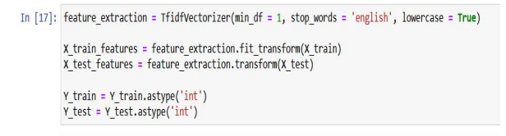
Transforming and fitting of data:

Slide 17
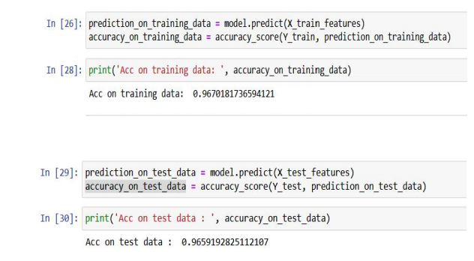
Applying prediction on both test and train data and testing the accuracy:

Slide 18
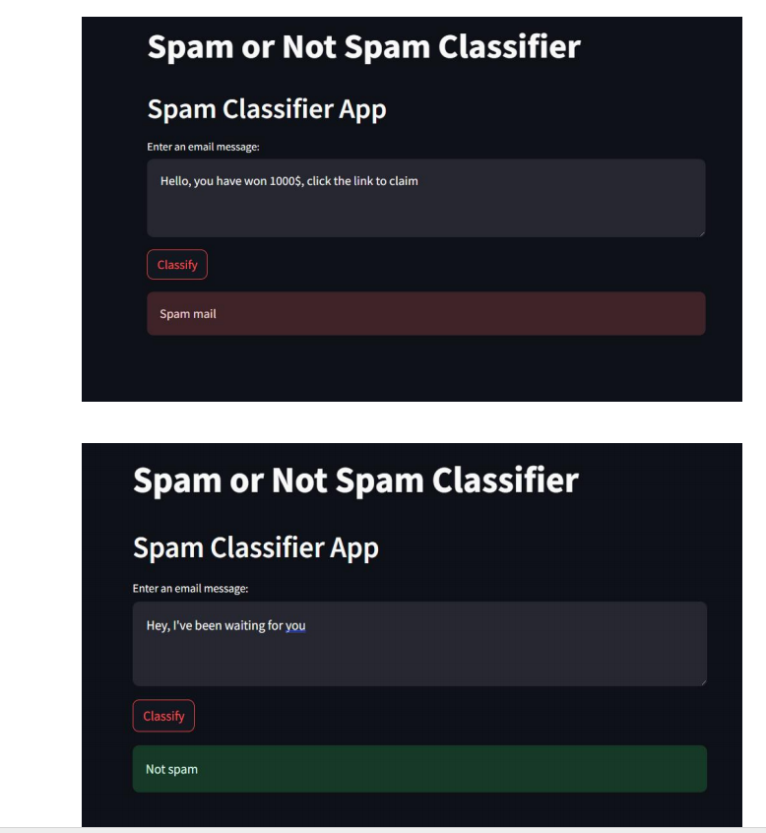
OUTPUTS:

